Slide 1
WORDS OF WISDOM WEDNESDAY
14 August 2019
Reserve Pay Processing – Best Practices
Notes:
Good morning or afternoon depending on your location and Welcome to our continuing series of “Words of Wisdom Wednesday” presentations. Todays session is all about Reserve Pay Processing and we will share some best practices in processing IDTs and AD Orders.
My name is ________ _________. I am one of the Training Specialists with the Pay and Personnel Center’s Procedures and Development Branch.
As a foot note, this session, like all our Wisdom Wednesday Virtual sessions is being recorded and will be posted shortly on the PPC (P&D) web page, along with a copy of the power-point and the Q&A questions for those that were unable to attend todays session.

Slide 2
PPC (P&D)
CWO Luke Scoville
Maddy Jackson
Kimm Valenzuela
Sandi Cottrell
Mark Lahan
Charlie Bartocci
Notes:
Here is the names of the rest of the PPC (P&D) staff…read names

Slide 3
PPC (MAS)
CWO Brian Spina
YN1 Mark Dubois
Notes:
Also joining us today are members of the PPC (MAS) staff. These guys are the ones in the trenches to ensure the proper processing of Reserve Pay issues….read names

Slide 4
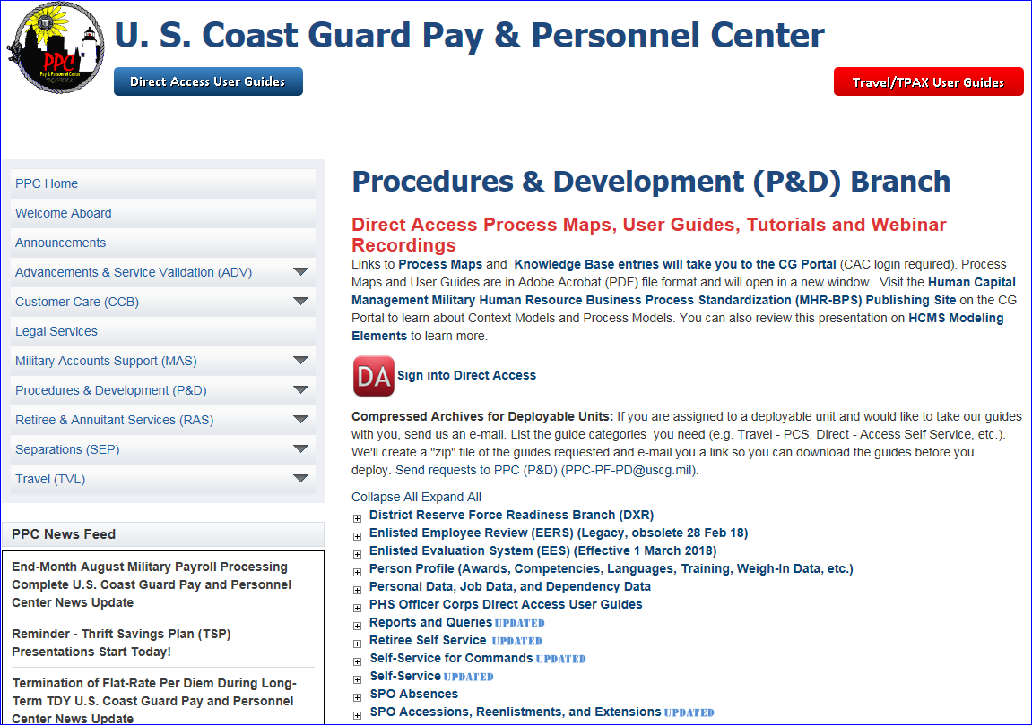
Notes:
Before we begin todays session, we would like to ask a few questions to the attendees:
(pull up poll question) Are You?
(pull up poll question) What is your duty station?’
Talk about the results of the polls individually….Thank you for your responses…now let’s begin todays session about Reserve Pay Processing…
(click) We would like to first talk about the PPC web page. The information on the web page could probably answer about 90% of the questions about pay and reserve issues. All the Direct Access user guides, virtual tutorials and access to the DA Knowledge Base can be found by clicking on the Direct Access User Guides button.
(click) I would like to point out two sections specifically…Self Service for commands and self-service for members.

Slide 5
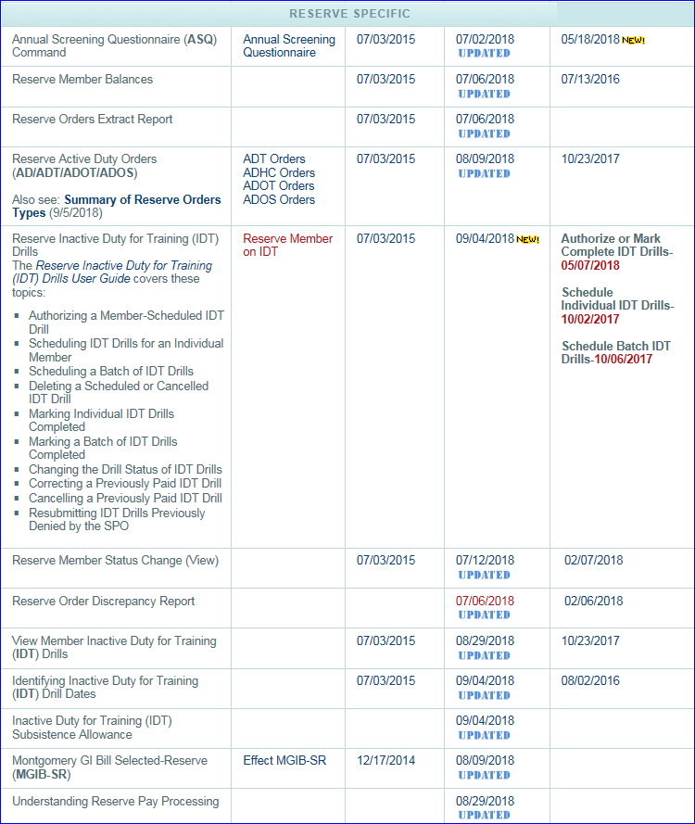
PPC
Direct Access
User Guides
Self Service
Command
Notes:
(click Just a quick peek at the SS for Command page…there is just about anything and everything a member needs to be able to obtain info and step-by-step user guide on “how to” to just about any personnel or pay transactions in DA. You can also click the link for the video tutorials for most of the subjects
(click) I would like to point out the link for “Understanding Reserve Pay Processing, which I will be spending most of my presentation today about.

Slide 6
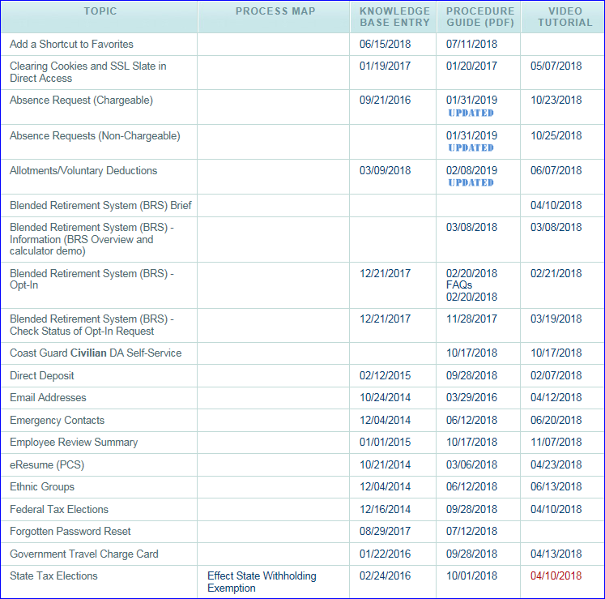
PPC
Direct Access
User Guides
Self Service
Member
Notes:
(click) The same info is available for members in the SS Member section.

Slide 7
Reserve Workshop
Notes:
At one time PPC would travel around the fleet and hold a “Reservist’ workshop…covering two days on a Saturday and Sunday during drill weekend to provide specific training on specific topics, such as Active Duty Orders….How to advance in the Coast Guard….ASQ, and a ton of other subjects. That came to a close, not sure why, but PPC converted the subjects into virtual recordings that a unit can just click, grab some popcorn and listen to the staff walk thought the topics. The links at the right are virtual recordings that walk through each topic.
(click) The Reserve Workshop will list the topics in alphabetical order
(click) A brief description of the topic and
(click) The Link/Length section with list the topic by name (as it appears in the user guide sections) and the length of the recorded session.
To access the session, just click on the link in the Link/Length column.

Slide 8
BIG Three!
Timeliness
Accuracy
Sequentially
Notes:
Timeliness – 3PM 2 business days to “complete” and 3 business days to “approve pay”. Discuss RETRO transactions.
Accuracy - Incorrect data on both IDT (meals/times); and AD orders (incorrect begin dates). Some SPOs don’t wait for emails (some never arrive) and process as ordered…problem members report earlier/later and orders must be amended at SPO which causes pay issues!!!
Sequentially – Need to be processed in sequence…for example a member starts ADT on a Monday, but did IDT Friday and Saturday. If SPOs are not paying close attention, they will process AD orders which makes the IDTs NOT process, and will be pushed 2 pay cycles!!! A member cannot be paid AD pay if in a “reserve” paygroup…and cannot be paid IDT pay if in an “active” pay group.

Slide 9
Topics
Inactive Duty for Training
Accuracy - Complete now
Email Now - Advise of AD orders
Active Duty Orders – Processing
Email Now on effective date
Advise of IDTs
Not TDY orders!
Order Discrepancy Report
Moon Junk

Slide 10
Inactive Duty for Training
Notes:
(click) Cannot complete IDT requests in DA….wrong TRAPAYCAT…or exceeds limit.
(click) Start/End times not reflecting 8 ½ hours if multiple drill.
(click) Inaccurate meal eligibility.
(click) Member not auth SDAP or FLP. IDT must be denied and returned to unit for fixin and resubmit.

Slide 11
View Member Drills
Drill Status/Approved | Definition
Scheduled/N | Scheduled/Not Authorized by Command
Scheduled/Y | Scheduled/Authorized by Command
Completed/N | IDT Completed/Forwarded to SPO for action
Completed/Y | IDT Completed/Approved by SPO for pay/allowances
Notes:
View Member Drills user guide – Will show where in process the IDT is.
A very important REMINDER….IF IDTs are submitted as a “batch”…if one of the IDTs is not correct and the batch is denied, ALL the other IDTs are also sent back to the command. NO IDTs are paid until the batch is resubmitted!!!

Slide 12
View Member Drills
Notes:
Scrolling to right of report will continue with the IDT information.
(click) The first four columns list the who/what/when the IDT was last touched. It will list the name/employee ID AND the time/date it was completed.
(click) The next four columns list who requested the IDT (member or command user) and when it was approved. It alt so lists the time/date the IDT was approved.
(click) The next section identifies who/when the IDT was approved by the SPO. It will list the SPO auditor by name/emplid and the time/date approved.
(click) The last sections is DA information. ALL IDTs are paid in what is called a “one time positive input”…that’s where DA calculates and put a one time credit to the members pay. It will identify the pay calendar and the time/date processed in DA. These last columns are more for SPO use to identify when the IDT pay processed.

Slide 13
View Member Drills
Notes:
Here is an example of a members IDT completed on 7/11/2018. The SPO “Approved” the IDT drill for pay while the member was currently on AD and in an AD Pay Group. The IDT will NEVER pay!!! The SPO must delete the IDT and resubmit after the member has returned to a Reserve Pay Group.

Slide 14
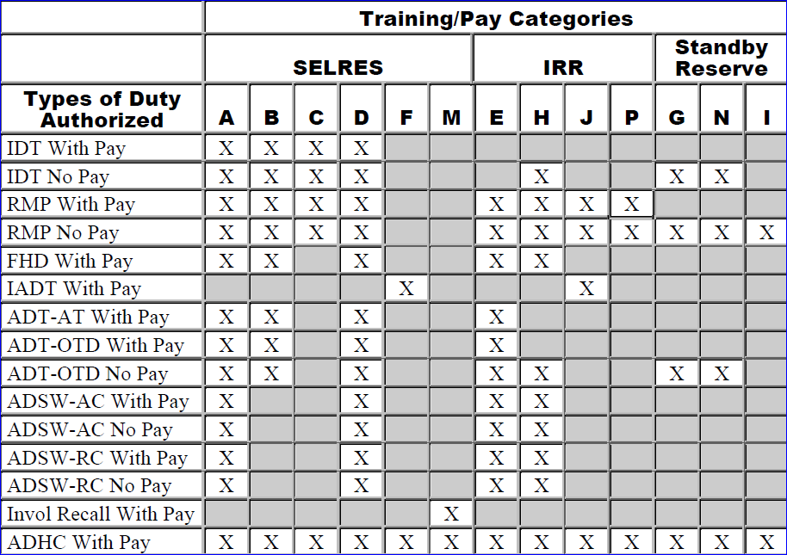
Training Pay Categories
Notes:
(CLICK) Here is the chart directly from the Reserve Policy Manual section 1.E concerning Training Pay Categories.
(CLICK) As an example, almost all reservists that perform their monthly IDTs are in a SELRES Training/Pay Category A. This means they can perform IDTs with or without pay…or any other type duty where an “X” identifies the type of duty.
(CLICK) Here is probably the most common non-compliance edit when requesting AD orders…the member is not in the correct Training/Pay category. When a reservist performs their initial active duty for training (IADT) when attending either basic training or A school…they MUST be in a TRAPAYCAT of “F”…when they return to the unit and start performing IDT’s their PAYTRACAT must be changed by the SPO to “A” to allow them to perform IDT’s for pay. What we typically hear is when a reserve member performed IDT’s and are not being paid…that’s because the SPO had not changed the TRAPAYCAT to “A”. Then when that same reservist later receives orders to “A” school…DA will not pay them AD pay because you must be in category “F” and the SPO must once again make the entry in DA. And when they complete “A” school…the SPO must yet again change them back to category “A”. So when you reservists, or Command or the SPO are creating reserve AD orders and you have a Non-Compliant TRAPAYCAT error…this is what is causing the AD Order Compliance issue to identify members orders are non-compliant.

Slide 15
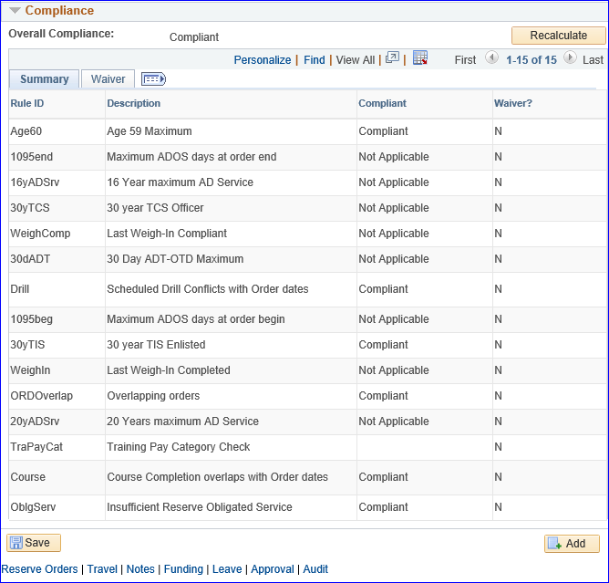
AD Order – Compliance Tab
Notes:
(click) Here is a snip of the Compliance tab on reserve orders. Big issue…AD orders are overlapping Scheduled Drills! Members enter IDTs and are not going to perform the drill and are trying to sched AD orders…probably AT orders and DA will not allow…non-compliant. Must delete the IDTs.
(click) Here is the trapaycat edit…if a member is in wrong trapaycat, the system will NOT allow orders to be process. You can save them in DA but not forward up the chain until these compliance issues are in order.
Suggest when creating orders…put type and dates on first tab then immediately go to the compliance tab to see if there are any edits that need to be tended to before finishing the orders. You will know up front and quickly if the orders will process.

Slide 16
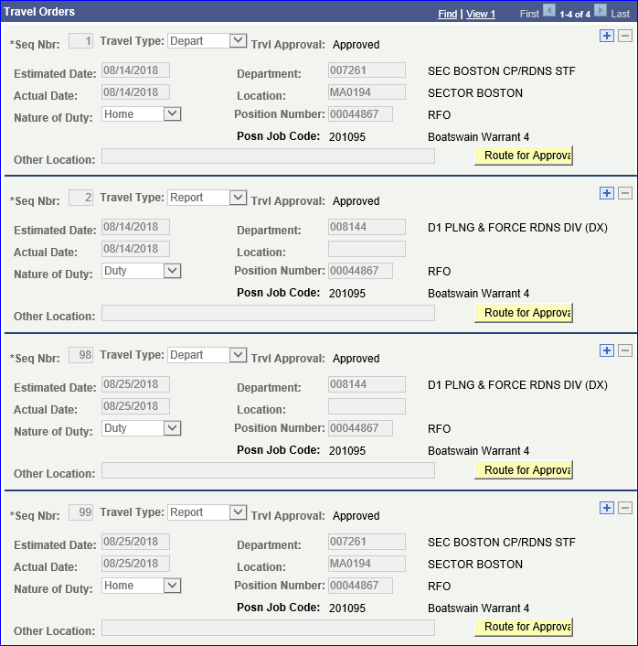
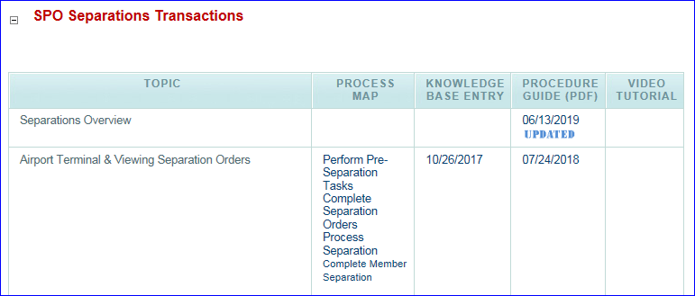
Do NOT add rows!
Notes:
* Scroll down the page to the Travel Orders section. This section is used by the SPOs since they record a members endorsements reporting and departing from active duty.
Reserve Orders are designed with 4 endorsement sections. These sections are identified as Sequence Numbers. Reserve AD orders are used to record a member departing and reporting for active duty and triggers direct access to turn on and off their AD pay and allowances.
(click) * Seq Nbr 1 is used to identify when the member departs home as ordered.
(click) * Seq Nbr 2 is when the member reports at the unit for duty.
(click) * Seq Nbr 98 is when the member departs the active duty unit
(click) * And Seq Nbr 99 records when the member arrived home, completing the AD.
DO NOT ADD OR DELETE ROWS. THESE ORDERS ARE NOT AND SHOULD NOT BE USED IN PLACE OF TDY ORDERS. Direct Access is not currently designed to understand sequence numbers other than 1, 2, 98 and 99. Adding/inserting rows can cause a delay or not accurately pay a member. And in many cases require manual intervention by PPC and/or programmers to correct the system.
(click) REMINDER for SPO Yeoman…when Reserve orders are LONG TERM and require a RELAD to be completed in DA. Please review the Separation Overview user guide for specific information on processing the RELAD.

Slide 17
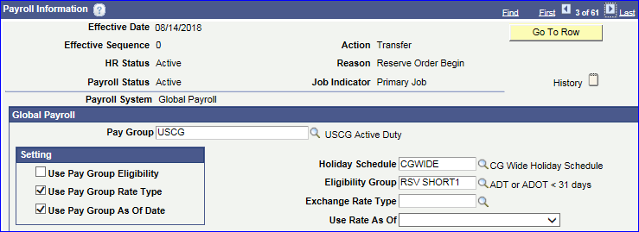
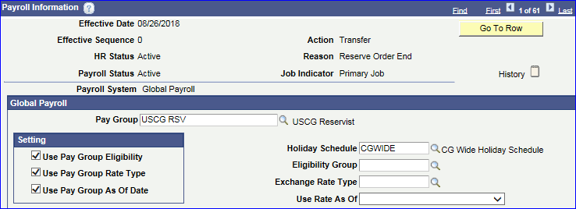
Reserve AD Order Job Data Rows
Notes:
Here are some Reserve member job rows.
(click) The top portion shows the Reserve Order Begin job data row, order endorsement 1 and 2 puts member in USCG (active) pay group and will identify the type of duty being performed…short term vs long term.
The bottom screen shot shows the Reserve Order End job data row for the ADT-AT. Notice that the end row is the day after they completed the ADT-AT to ensure the member was paid through their last day of Active Duty. The 98 and 99 endorsements puts the member back into a USCG RSV (reserve) pay group and can now be paid IDT pay/allowances.
You cannot insert a job row behind an existing job row. For instance, if this member was due a longevity increase on 8/15/2019, DA automatically builds the job data row for the pay increase. Then the SPO approves the reporting endorsement on 8/16…DA will NOT go behind the 8/15 pay increase job data row to add the 9/14 reserve order begin row. Does that makes sense? Only PPC has the roles to add or delete job rows. We would have to manually build this job row. A PPC help ticket MUST be submitted to build the 8/14 row to put member in active duty pay group and process AD pay/allowances. DA will NOT pay the AD pay until this happens.
Another best practice…if there are back-to-back order with short gap in between…FINISH the first set (the 98/99 row), approve the endorsements, verify the ROE job row built, THEN report them aboard on the new orders.

Slide 18
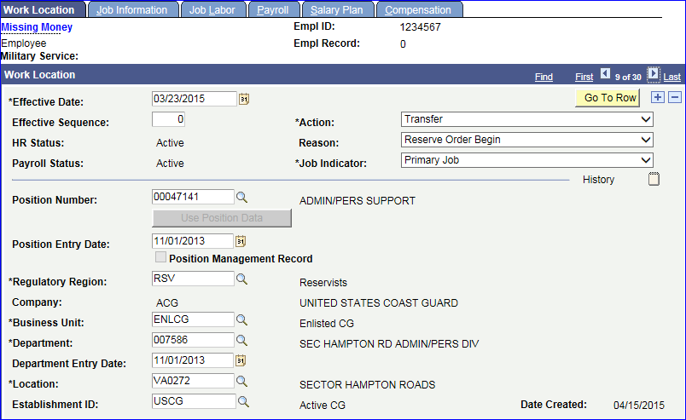
Example of how timeliness
can burn the member
Notes:
Here’s an example of how timeliness can burn a member.
This member started her Title 10 orders on 3/23/15. When was this job row created? Click.
So that means this member didn’t get her first paycheck until a 1 May paycheck…over a month after starting AD.

Slide 19
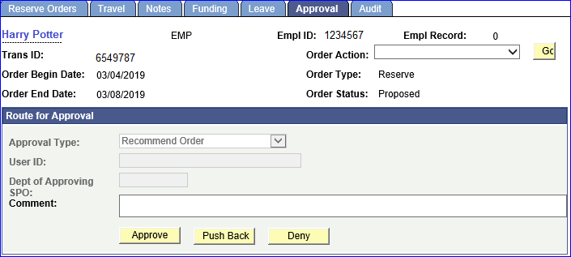
Reserve Order Approval
Notes:
Want to take just one minute to remind SPO’s of the Push Back button on reserve orders. We all know what approve or deny means. But there are YN’s that still do not understand what the Push Back function does.

Slide 20
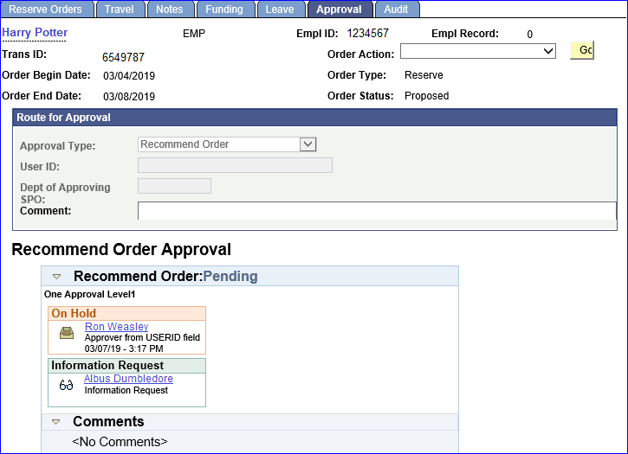
Reserve Order Approval
Notes:
When using the Push Back option, the orders are returned to the person that forwarded for approval. The status will show Pending, and will be placed On Hold, and her is the key…FOR THE PERSON WHO SUBMITTED THE ORDERS for approval. So in this example, Ron Weasley and ONLY Ron Weasley can now touch these orders. Nobody else can take any action on the orders.
So, please do NOT use the Push Back option unless you know for a fact the person they are being returned to is available to edit and resubmit.

Slide 21
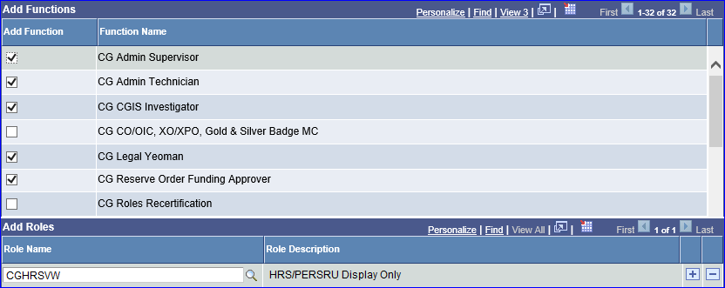
Direct Access
Notes:
The five checked Functional Roles automatically come with the HRSVW role. If you do not have one of these functional roles, (CLICK) you can request just the HRSVW as seen here.

Slide 22
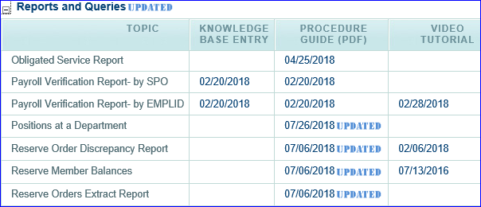
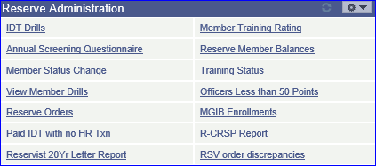
Reserve Order Discrepancy Report
Notes:
Review the Res order Discp Report user guide. A complete list of all the discrepancies can be found in the Reports and Queries and the Reserve Specific section of the Self-Service for Commands user guides.
To access the report, you must have the CGHRS, CGHRSUP, CGRSVMGR, CGSSCMD or CGRSVISC user role.
The Reserve Order Discrepancy Report identifies Reserve Orders entered into Direct Access that need to have action taken to cancel, or process the orders to an En route or Finished status.
Administrative Offices, SPOs, District (dxr) and RFRS Staffs, DOL, and PAC-13 should run this report to ensure complete and timely processing of all Reserve Active Duty orders.
To access the report, click on the RSV Order Discrepancies link in the Reserve Administration pagelet.

Slide 23
Reserve Order Discrepancy Report
Notes:
(click) When the report appears, you can download into Excel spreadsheet for easy sorting.
(click) In this example the first order shows the orders are “authorized”, the begin data has passed and the orders are not en-route (member reported aboard) or finished. This tells me that the member has orders, should have reported aboard but NO pay and/or allowance have been started. This report was ran in early September and the orders were for period 8/27-31. It has been almost a month and members has not, and will not receive any AD pay and/or allowances until they are reported aboard. So this report is an excellent research tool when a member calls and says “I haven’t been paid anything yet”….As a reminder, command members with the SSCMD, RSVCMD, or CGHRSVW user role. So commands can run this report frequently to have an updated status of members orders.

Slide 24
Reserve Order Discrepancy Report
Discrepancy | Description
Authorized Orders with Begin Date Past Not E, F | Reserve order is not in an En Route or Finished status and the begin date of the order past current date of report. SPO action needed either to process to an En Route or Finished status or cancel the order.
En Route or Finished Orders with No ROB Job Row | Reserve order is En Route or Finished status with no Reserve Order Begin (ROB) Job Row to begin AD Pay on the Actual Begin Date of the order (Seq Nbr 1). Contact PPC for action. PPC (ADV) will create a Customer Service help ticket and inform the SPO if any further action is required.
Finished Order With No ROE or RLD in Job | RSV order is in a Finished status, but no Reserve Order End (ROE) Job Data row built to shut down member’s entitlement to AD Pay on Actual End Date (Seq Nbr 99). Contact PPC if Short Term orders. Complete required RELAD event if Long Term orders.
Orders With Travel Actual Dates Not Pending/Approved | Orders contain an Actual Date in Sequence 1, 2, 98, or 99, with Travel Approval blank. Contact PPC for action.
Notes:
Here are a few more examples of reported discrepancies.
(click) We already talked about the first note…
(click) Lets talk about the second note…The orders are en route or finished status with no Reserve Order Begin (ROB) job row…pay has not been started.
(click) The third entry is the orders are Finished with no Reserve Order End (ROE) or Release from Active Duty (RELAD)…this means the members pay has not been stopped, and are not in an overpaid status. For the SPO Yeoman listening in….remember long term reserve orders require a RELAD vs just entering dates in the 98 and 99 rows on the reserve orders.

Slide 25
Reserve pay References
(To list just a few)!!!
Reserve AD Orders User Guide
Separation User Guide SPO
Understanding Reserve Pay Guide
Notes:
Here are just a few important references concerning Reserve Pay
Read the references….

Slide 26
PPC-PF-PD@USCG.MIL
Notes:
This concludes our Wisdom Wednesday session concerning Reserve pay.
(pull up Poll question) We would like to know if this information was helpful and useful?
Talk about the poll results…
OK, we will now open up the session to your questions. We have some of PPC’s subject matter experts in Reserve Pay on line to try and answer your questions. As a foot note, this session, like all our Wisdom Wednesday Virtual sessions is being recorded and will be posted shortly on the PPC (P&D) web page, along with a copy of the power-point and the Q&A questions for those that were unable to attend todays session. We highly encourage to share this information with all Reservist, commands and SPOs.
So Tell us what you think!!!

